Slide 1

EXPENSE CALCULATOR
k.manasa(192011125),cse
T.Hema varshitha(192011258),cse

Slide 2
OBJECTIVE
The purpose of a expensive calculator is to do calculations correctly and efficiently.
It is clear that a calculator should relieve the user from the need to do mental operations and of the need to rely on paper as far as possible.
It is used to calculate our montly or yearly saving and expenses of our income.

Slide 3
ABSTRACT
Calculator is used to make our calculations easier.
This project work also focused principally on the expenses in our daily life.
expense calculator is an estimate and planning of income and expenditure, and commonly refers to a methodical plan to spend money in a certain way.
A simple expense calculator lets you add income and expenditures in a simplified manner.

Slide 4
ABSTRACT
The application contains a single Activity with a Recycler View.
Two Edit Texts (one to enter amount and the other to enter a short note of the transaction), 1 clickable Text View to specify loss or gain, 1 clickable image to add the transaction to Recycler View, and finally a custom Action Bar to show the balance.
It includes Shared Preferences to store the data locally.

Slide 5
INTRODUCTION
Expense Calculator in a mobile application based on android technology.
Any Individual can install it in their smart mobile.
phone running on android operating system Retailer and shop owners of small businesses in rural and local areas often use paper to record their expenses
It can use to ease the jobs and can move all records at one place without any fear of data loss .

Slide 6
INTRODUCTION
Students can use to record their spendings so that they can move their unwanted expenses
It can be used as a calculator to calculate expenses along with mapping category that in which area the money is going for example clothing, food, travelling etc

Slide 7
INTRODUCTION
Calculators are the main devices which are used to perform arithmetic operations but they do not have enough memory to move the calculated data for future use
And also do not have any category options to save the expense associated with So to fill these gaps this expensive calculator app is better idea.
Calculators are the main devices which are used to perform arithmetic operations but they do not have enough memory to move the calculated data for future use and also do not have any category options to save the expense.

Slide 8
EXISTING SYSTEM
In existing, we need to maintain the excel sheets, csv etc. files for the user daily and monthly expenses.
there is no as such complete solution to keep a track of its daily expenditure easily.
to do so a person as to keep a log in a diary or in a computer, also all the calculations needs to be done by the user which may sometimes results in errors leading to losses.
to reduce manual calculations, we propose an application which is developed by android.

Slide 9
PROPOSED SYSTEM
The expense calculator allows users to maintain a digital automated diary.
This application takes income from user and divides in daily expense allowed.
In additional, with the financial expenses application, it able to knows user own habit on spending too much on particular categories.
Response time of calculations has been improved.

Slide 10
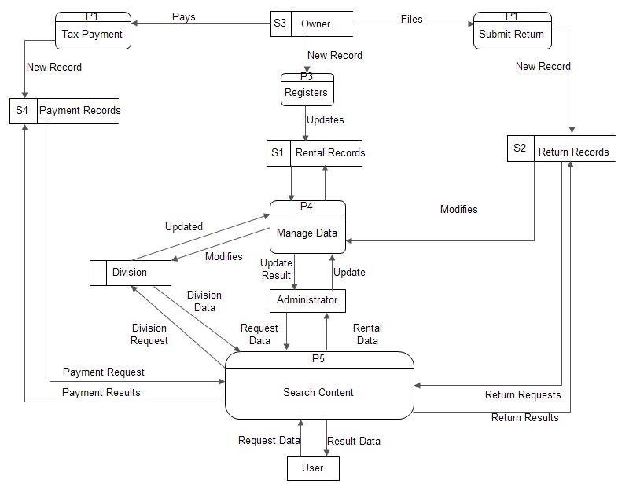
DATAFLOW DIAGRAM
The data flow diagram includes:

Slide 11
SOFTWARE REQUIREMENTS
Android studio
java jdk
Xml
Emulator
Gradle build
Native application support

Slide 12
HARDWARE REQUIREMENTS
PROCESSOR : dimensity 1200-AI octa-core
RAM : 8 Gb
ROM : Atleast 128 GB storage.

Slide 13
MODULE DESCRIPTION
JAVA MODULES:
transactionclass.java:
This module contains the main calculator code.
Transactionadapter.java:
This module contains the code for transaction list.
MainActivitiy.java:
This module contains the code for the app implemented.

Slide 14
MODULE DESCRIPTION
XML MODULES:
Ic_send.xml:
This xml file contains the code for calculator interface.
Ic_balance.xml:
This xml file contains the balance.
etbg.xml:
This xml file contains the code for the app interface.

Slide 15
MODULE DESCRIPTION
Add expenses: This module will allows a user to add their expense and in the app
Delete: This module will allows a user to delete their saved data in the app
Category: This module will allows a user to add category associated to their expense.
Edit: This module will allows a user to edit their saved expenses

Slide 16
MODULE DESCRIPTION
Add income: This module will allows a user to add their income pocket money, salary etc
Currency: This module will allows a user to choose their currency like rupee, dollar etc
Show Expenses: This module will allow a user to show their expense records
Trends: This module will show in which category most of the money is going

Slide 17
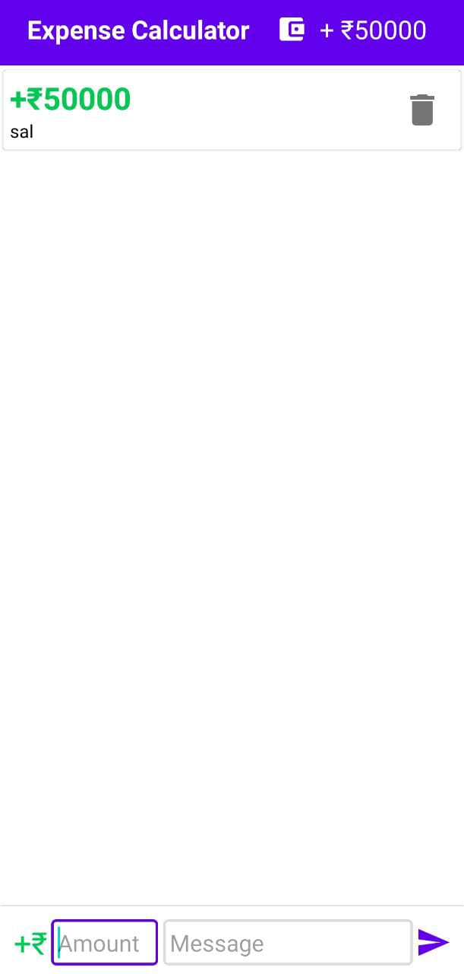
OUTPUT
The expense calculator of every day needs:

Slide 18
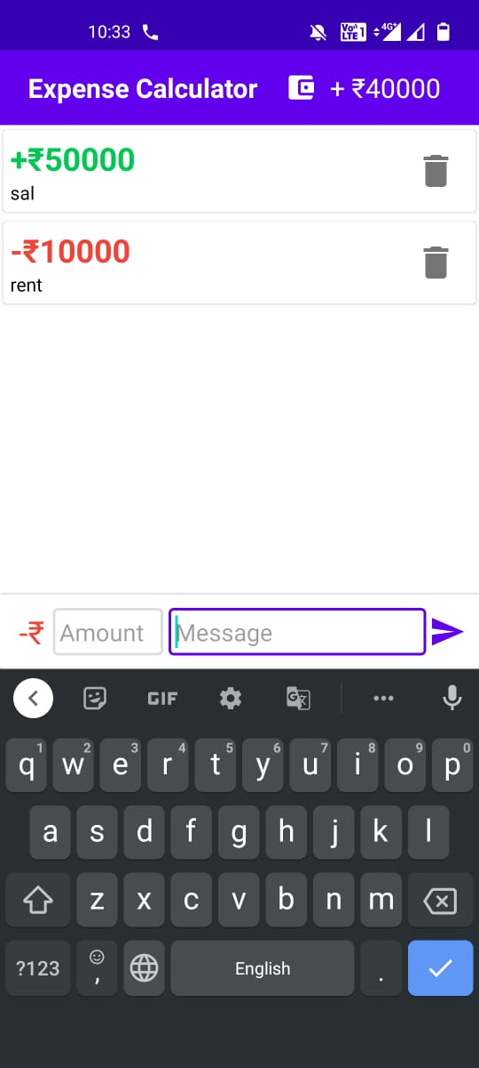
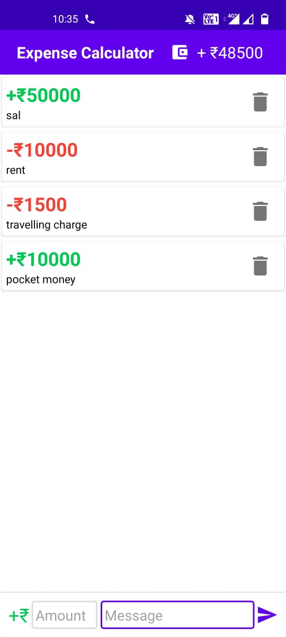
OUTPUT

Slide 19
FEATURES
It is easy and comfortable to use.
The application can be easily downloaded and installed on any android device and tablet.
It provides the facility to perform fundamental mathematical operations.
The application gives fast and accurate result.
This application consumes very small power of your Device.

Slide 20
ADVANTAGES
Expensive calculator learns how to gain control of your saving and spending.
Expensive calculator uses to plan for our savings goals and manage our expenses.
It is also helpful for making the clear view of our expenses.

Slide 21
CONCLUSION
This app will be helpful in saving our monthly expenses And avoid unwanted expenses Tracks where our most of the money ingoing Hence will help in spending wisely and efficiently.
A simple user interface has been created to demonstrate the calculator.
The interface addresses the problem of allowing the user to view a (potentially time consuming) calculation as it proceeds but also giving an answer which can be used or checked, by outputting signed digits as they are computed and then converting the result into decimal when some specified precision is reached.
It is very friendly and easy to use.

Slide 22
FUTURE ENHANCEMENT
Improvement of more security and privacy(only the persons who having access).
Adding of graphs and brief suggestion calendar on excess expenses.
Calculating the inflation rate of future.
Give suggestions on some percentage of salary or income to implement on future home or loans.

Slide 23
REFERENCES
www.android.com
www.java.com
Android Programming: The Big Nerd Ranch Guide
Android Programming: Pushing the Limits
https://developer.android.com

Slide 24


